Slide 1
Governor’s Advisory Board for Telecommunications Relay
January 26, 2023

Slide 2
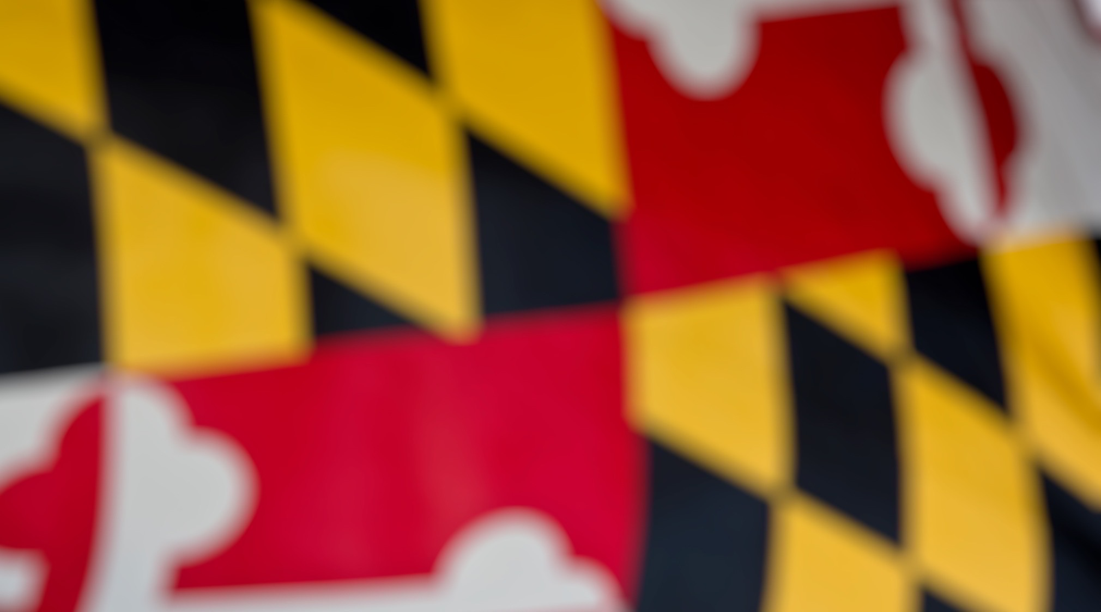
Roll Call
David Drezner
MCOD rep
Payal Sharmacharya
MDODHH rep
Glenn R. Lockhart
Michelle Lionie Morales
Allysa A. Dittmar
Mr. Alex Simmons
Darrin R. Smith
Kenneth Putkovich
Steven D. Cooper
Lori Markland
Ms. Shannon R. Minnick
Alfred Sonnenstrahl
Deirdre Cheek Lynch Esq.

Slide 3

Director’s Report
David Bahar
Director
David.Bahar@Maryland.gov | 240-319-9199 (SMS)

Slide 4


General Updates
Welcome Brandie Callender to the team!
Legislative session underway – budget hearings estimated for mid-late February
Board training took place last week
  Most board members were able to participate and had a positive experience.
Director’s Report

Slide 5

Feedback/Questions?

Slide 6
Finance Manager’s Report
Leslie Hannibal
TAM Finance Manager
Leslie.Hannibal2@Maryland.gov | 443-767-6971 (office)

Slide 7
Beginning Balance
Finance Manager Report

Slide 8
Expenditures
Finance Manager Report

Slide 9
Revenue
Finance Manager Report

Slide 10
Ending Balance
Finance Manager Report

Slide 11
Questions?

Slide 12

Manager’s Report
Travis Dougherty
Maryland Relay Manager
Travis.Dougherty@Maryland.gov | 202-753-9119 (VP)

Slide 13
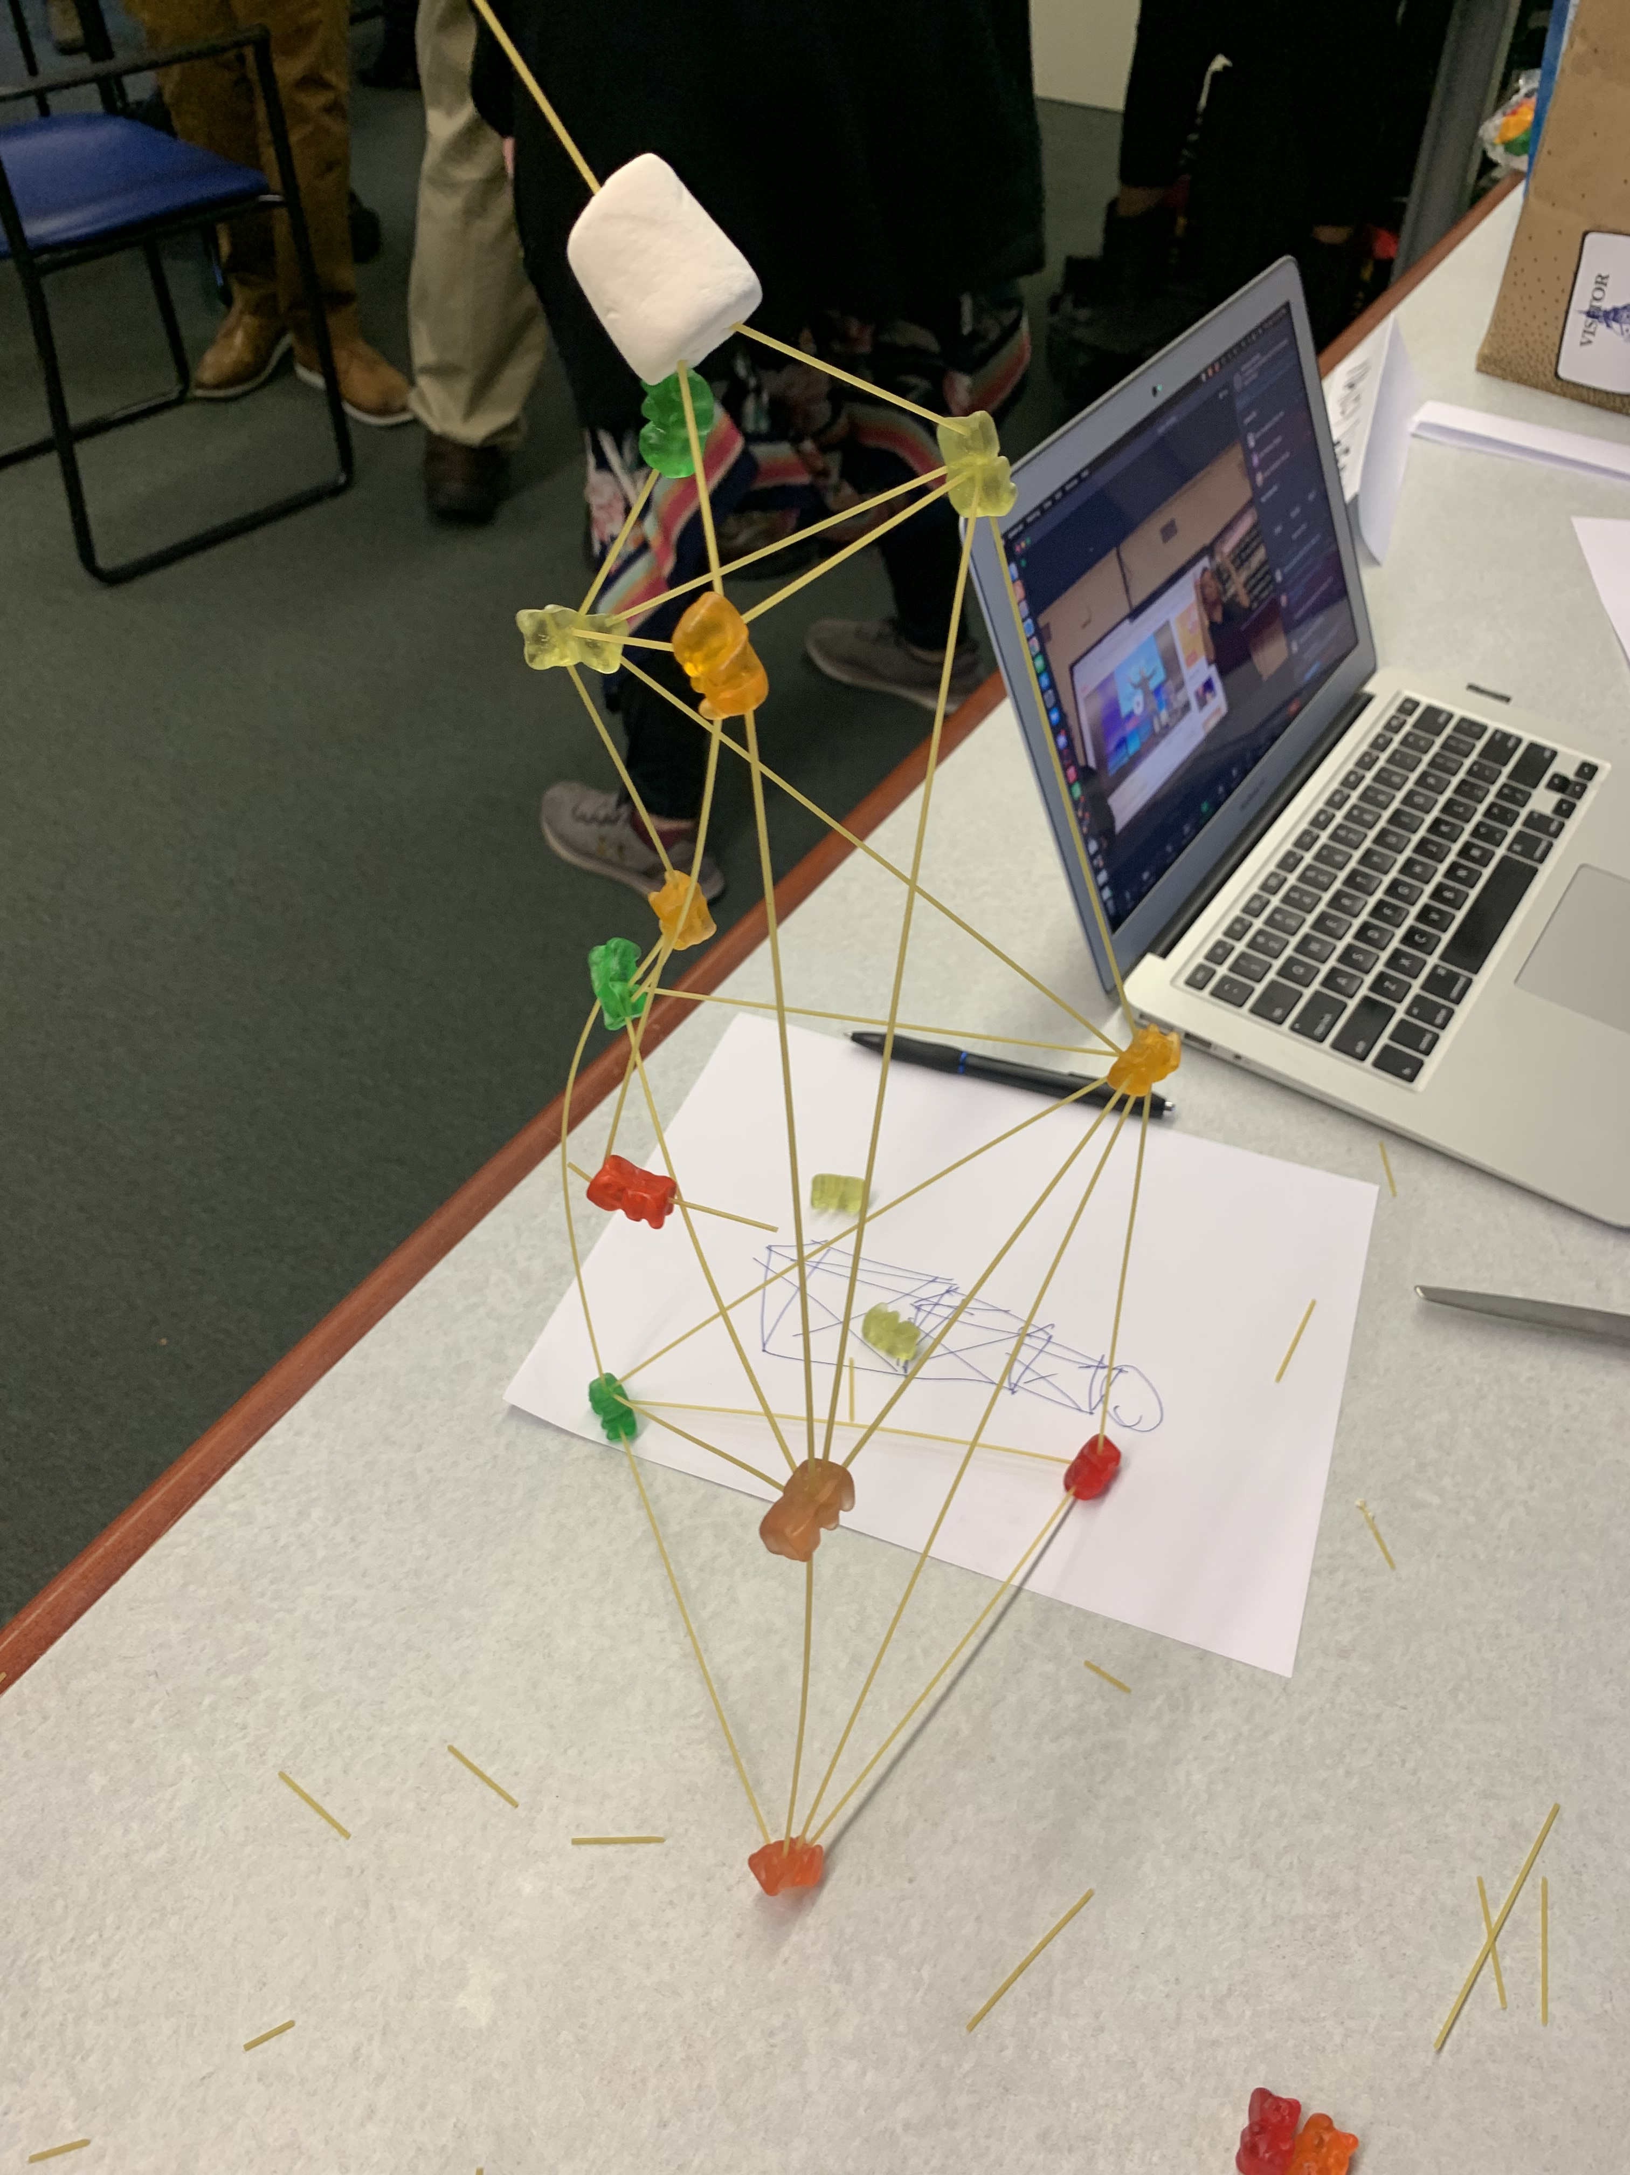

General Updates
Board Training
NASRA
Maryland Relay Manager Report

Slide 14
General Updates
The Fall of Analog Relay Services
Maryland Relay Manager Report

Slide 15
General Updates
Universal Telecommunications Access Platform
Maryland Relay Manager Report

Slide 16
Questions?

Slide 17

MAT Manager’s Report
Kevin Steffy
MAT Manager
Kevin.Steffy@Maryland.gov | 443-852-6717 (SMS)

Slide 18
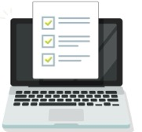
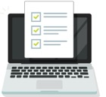
General Updates
From October to December 2022, MAT has received 122 new applications and distributed a total of 133 pieces of telecommunications equipment.
In the previous quarterly report, we received 69 new applications and distributed a total of 11 pieces of telecommunications equipment.
122
69
new applications
new applications
pieces of telecommunications equipment
133
pieces of
telecommunications
equipment
11
MAT Manager Report

Slide 19
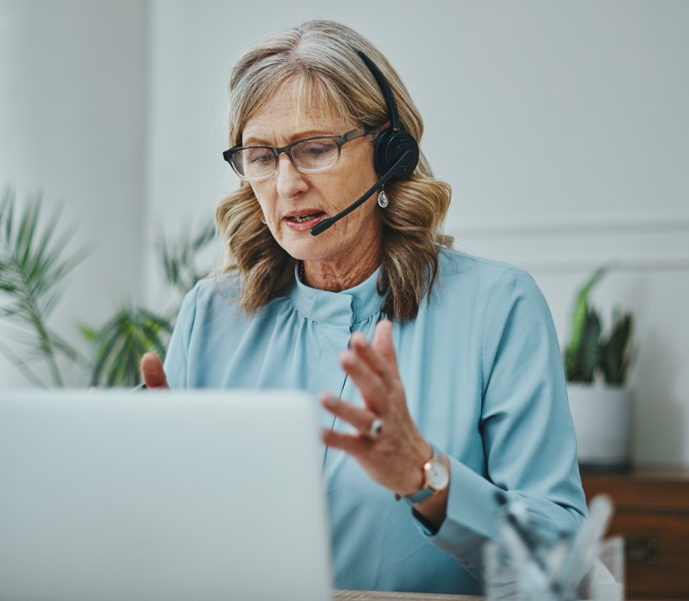
Communication Facilitator (CF)
From October to December 2022, the CF service has provided 107 services. In the previous quarterly report, we provided 60 services.
The video conference calls were for committee/board/town hall meetings, webinars, interviews, memorial services, alcoholics anonymous meetings, VP calls, and training.
As of today, we have 11 DeafBlind users.
MAT Manager Report

Slide 20
Oregon’s CF Program
Effective Program Date: January 2, 2023
Rates for facilitators (weekday, night, weekend, last minute, facilitate, protactile (PT), legal, or medical).
Training for facilitators (facilitating, PT, legal, and medical)
MAT Manager Report

Slide 21
Questions?

Slide 22
Public Relations & Outreach Report
Donna Broadway-Callaman
Community Outreach Manager
DonnaT.Broadway-Callaman@Maryland.gov | 443-240-9969

Slide 23
What’s New With Maryland Relay?
We are currently in our preparation season. We recently attended Winter MACO in Cambridge where we made a bunch of good connections and we are even scheduled to meet with Senator Cheryl Kagan, from Montgomery County to talk about our program and give information.
We are preparing for a few events including:
  Northeast Maryland Senior Conference
  St. Elizabeth School Special Needs Fair
  B’More Healthy Expo
  Blind Health Expo
  And several exhibits at the various branches of the Baltimore County Public Library
Public Relations & Outreach Report

Slide 24
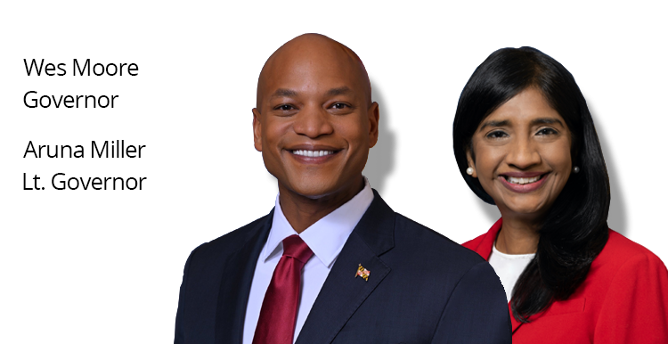

What’s New With Maryland Relay?
We are working closely with the teams at MDoD, namely Yesheva Kelly, and DoIT to migrate from our old platform onto the MDoD platform. The process is ongoing and the date remains TBD.
Governor Wes Moore was sworn in Wednesday, January 18th and we will keep you updated with any major updates with public affairs, language, wording, etc. anything that can affect our core audience.
Public Relations & Outreach Report

Slide 25
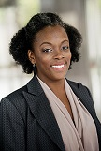
What’s New With Maryland Relay?
Tarita Turner’s (TRS Outreach Coordinator) last day was in November.
Jenny Pearson is still with Hamilton and is helping the outreach team until we have a suitable replacement.
Hamilton has access to Tarita’s email so we won’t miss any events she may have scheduled before her departure.
I want to take this time to formally thank Tarita for her hard work and dedication to Maryland Relay. She was with us for many years and is a valued part of our team. We wish her the best of luck with her future endeavors.
Public Relations & Outreach Report

Slide 26



What’s New With Maryland Relay?
At our last meeting, I discussed increasing our visibility using social media.
Former Governor Larry Hogan banned the use of TikTok on government devices. We will not be using TikTok but will continue to use our existing platforms to create content that promotes our programs and various phones and equipment, as well as statewide awareness days and initiatives.
Outreach has a designated email, tam.outreach@Maryland.gov, that we will use for RSVP’s and special outreach projects.
@MDRelay711
facebook.com/
MarylandRelay711
@MDRelay711
Public Relations & Outreach Report

Slide 27
Continued Outreach Efforts
Advertising
Webinars
Mailings
Virtual/Hybrid Events
Networking/Making New Contacts
Field Visits
Television ads/
paid segments
Public Relations & Outreach Report

Slide 28
Questions?

Slide 29
Thank you!
January 26, 2023

